Slide 1

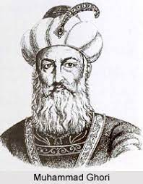
Dawood University of Engineering & Technology
MUHAMMAD GHAURI (1149-1206)
Lecture # 4
https://www.clearias.com/muhammad-ghori/

Slide 2
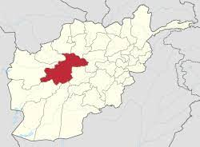
INTRODUCTION
Muhammad Ghauri was a Turko-Islamic invader from Afghanistan whose conquests led to the establishment of Islamic sultanates in India.
Muhammad Ghauri, or Shihabud din Muhammad Ghauri, was the true founder of the Muslim empire in India.
Muiz-ud-din Muhammad bin Sam, also known as Muhammad of Ghaur, Muhammad Ghauri, or Shihabud din Muhammad ghori was born in 1149 CE in Ghaur.

Slide 3
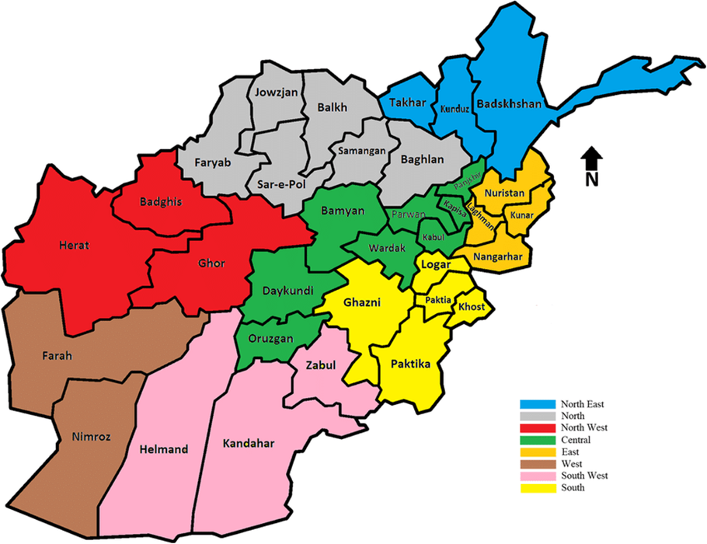
In 12th century between the Ghaznavi and Herat Ghaur are located. A ruler Alauddin Ghauri came un 1155 A.D.
The Ghauri power increased under sultan Alauddin who was also known as Jahan-soz (the world burner)
And he also captured Ghazni from Ghanavi’s. After his death his nephews came in to power.
Ghiyath-ud-Din Muhammad and Mu’izz –ud-Din Muhammad or Shihab-ud-Din Muhammad.
Ghiyath ud Din Muhammad was King of Ghaur and his younger brother Shihab ul Din Muhammad known as Muhammad Ghauri was Commander-in-Chief of his army.

Slide 4
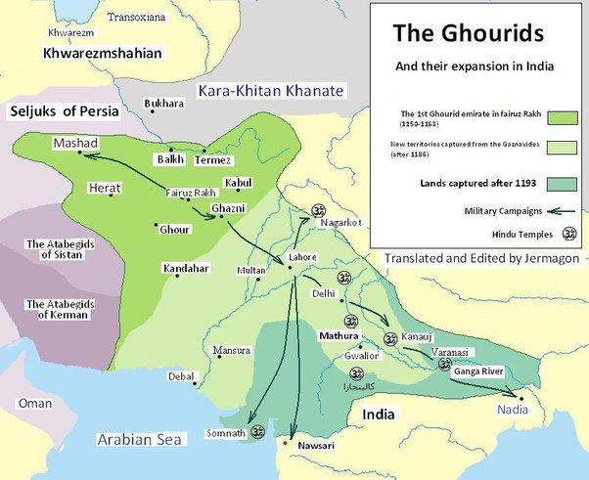
Nearly 150 years had lapsed after the last invasion of Mahmud of Ghazni in 1027. But Indians did not develop the necessary processes and protections to meet the new challenges from outside.
In 1175 CE, Muhammad Ghauri took the Gomal pass and conquered Multan and Uchch in the northwest of the Indian subcontinent.
He also captured Sindh in 1182 & Lahore in 1186. and appointer Nasir-Uddin Kabacha and Qutubuddin Aibak as Governor respectively.
Muhammad-bin-Baktiyar Khilji, another general of Ghauri, led a military expedition against Bihar and Bengal appointed Governor of Bengal.

Slide 5
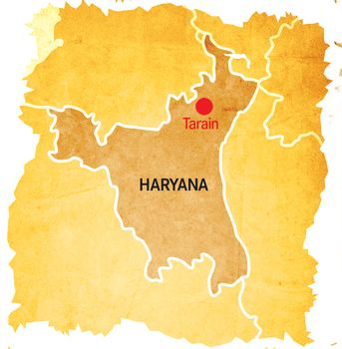
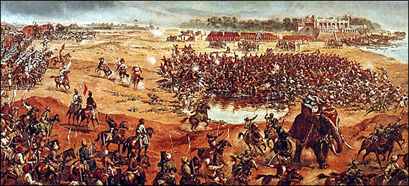
FIRST BATTLE OF TARAIN 1191 A.D
In 1191, Muhammad attacked and captured Tabarhind or bhatinda, a part of Prithviraj Chauhan’s dominion. This led Ghauri to come into direct clash with Prithviraj Chauhan who was one of the most powerful Rajput rulers.
The enemies met each other on the battlefield at Tarain, 80 miles from Delhi.
Muhammad Ghauri was defeated in the battle but managed to escape; the battle was completely won over by the Rajputs.

Slide 6
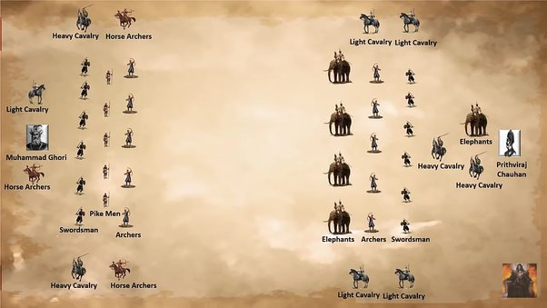
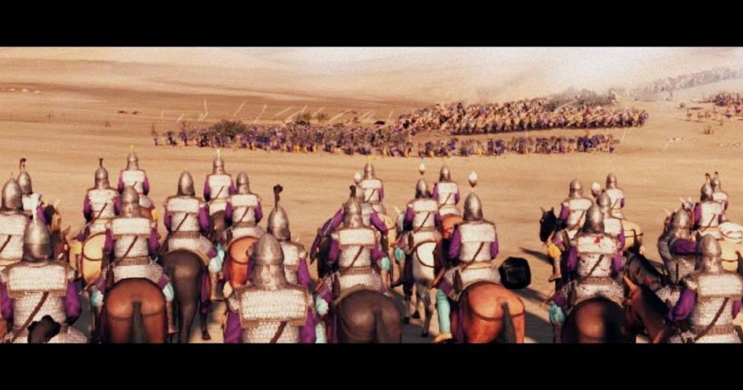
SECOND BATTLE OF TARAIN (1192 CE):
Muhammad Ghauri went back to Ghazni and prepared his army for the next attack to avenge his defeat with more strategy and power this time.
Prithviraj also organized the Hindu confederacy to resist Muhammad Ghauri, but it was weaker this time.
In 1192 CE, both armies met again on the same battlefield Tarain. This time Muhammad defeated Prithviraj Chauhan and Ajmer and Delhi were occupied by Muhammad Ghauri.
The battles of Tarain are known as the turning point in Indian history as they opened the way for further conquests of India by the Muslims.
After the battle of Tarain, Muhammad appointed Qutubuddin Aibak, one of his slave generals, as the viceroy of the Indian provinces.

Slide 7
Islamic Rule
No ruler in Rajputs who stop to further advance Muslims in India
Ghori destroyed the pillars and foundation of idol temples and built in their mosques and colleges and the percepts of Islam and the customs of the law were tell and established.
Son of Prithvi Raj was made as the ruler of Ajmer and he promised to pay tribute. Mohammad of Ghori treat their slaves like children.
Mohammad Ghori went back to Ghazni, leaving one of slave it was a deciding victory by Muhammad of Ghor and end of Prithviraj Chauhan in charge of his Indian assets, in short time Qutb-ud-din-Aibak conquered Meerut, Kol and Delhi.
And made Delhi the seat of his government (Slave Dynasty) rule of Muslim after this battle come to existence. Sultanat of Delhi and became sultan

Slide 8
Death of Ghori
His way back to Ghazni, his caravan rested at Dhamiak near Sohawa (which is near the city of Jhelum in the Punjab province of modern-day Pakistan).
He was assassinated on March 15, 1206 while offering his evening prayers. His killers are unconfirmed. It may have been the Khokhars.
Ghor Leadership Muhammad of Ghor leadership styles always be an inspirational situational, autocratic, influential, coaching style, democratic style little inputs from team members visionary leadership motivating others opinion

